Slide 1

JBD AI Weekly Report
2023.10.13

Slide 2
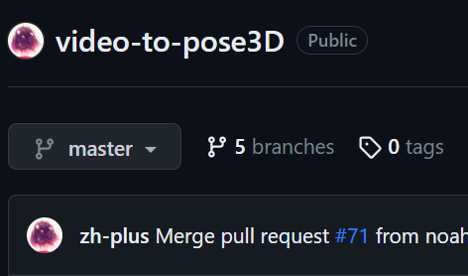
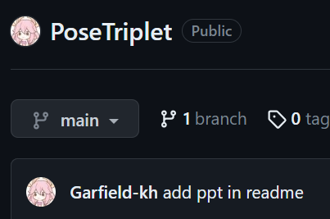
RD weekly report
Owner：AI算法课长：何明荀
本周共有3星难点1个, 2星难点1个。
A driver behavior monitoring system using body part coordinates and AIGC
Research 2D-to-3D pose models and applications
Difficulty rating技術難度：🌟🌟🌟
Difficulty rating技術難度：🌟🌟
Technical difficulties技術難點：
Apply our patent to TAOS system
Technical difficulties技術難點：
Research the related paper and codes
Many bugs in the codes: config, weights, ...
Solution 解決方案：
Revise all the documents
Understand the information required for declaration
Fill the form with the information
Solution 解決方案：
Find the related papers and codes
Read the papers
Fix bugs
Solution effects 解決效果：
- Complete patent application
Solution effects 解決效果：
Understand the papers and applications
There are still bugs.
Plans for next week下週計劃：请各位主管签核
Plans for next week下週計劃：Inference the codes

Slide 3


